Slide 1
Real-Time Threat Detection using AWS Microservices
Final Project
CS-GY 9223 - Cloud Computing - Fall 2022
Vishal Prakash (vp2181@nyu.edu)
Vedang Mondreti (vm2129@nyu.edu)
Rishab Singh (rs7623@nyu.edu)
Eashan Kaushik (ek3575@ny.edu)

Slide 2
Overview
Problem Statement
Need for an automated surveillance system
Generate alerts when there is a home intrusion
Solution
GuardDog
Product Features
Intruder Alerts
Person and Face Detection
Facial Recognition
Signed URL for video access

Slide 3
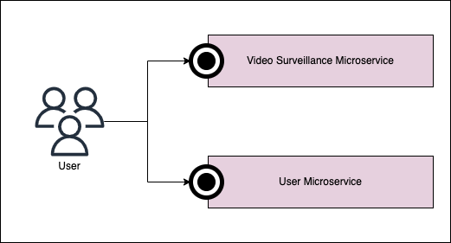
Design Flow
User Microservice
CRUD operations for front-end
Generate pre-signed URL
Create/Delete/View labels
Display alerts
Video Surveillance Microservice
Capture video through any camera
Image recognition using Rekognition
Video Processing using Kinesis
Generate Alerts and Send Email

Slide 4
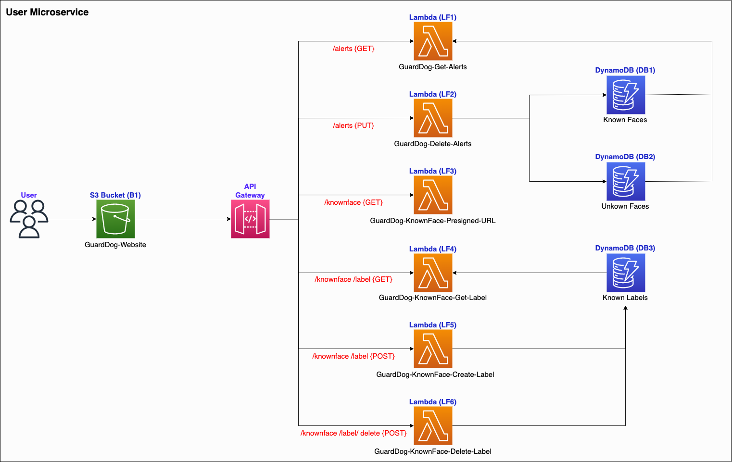
Architecture

Slide 5
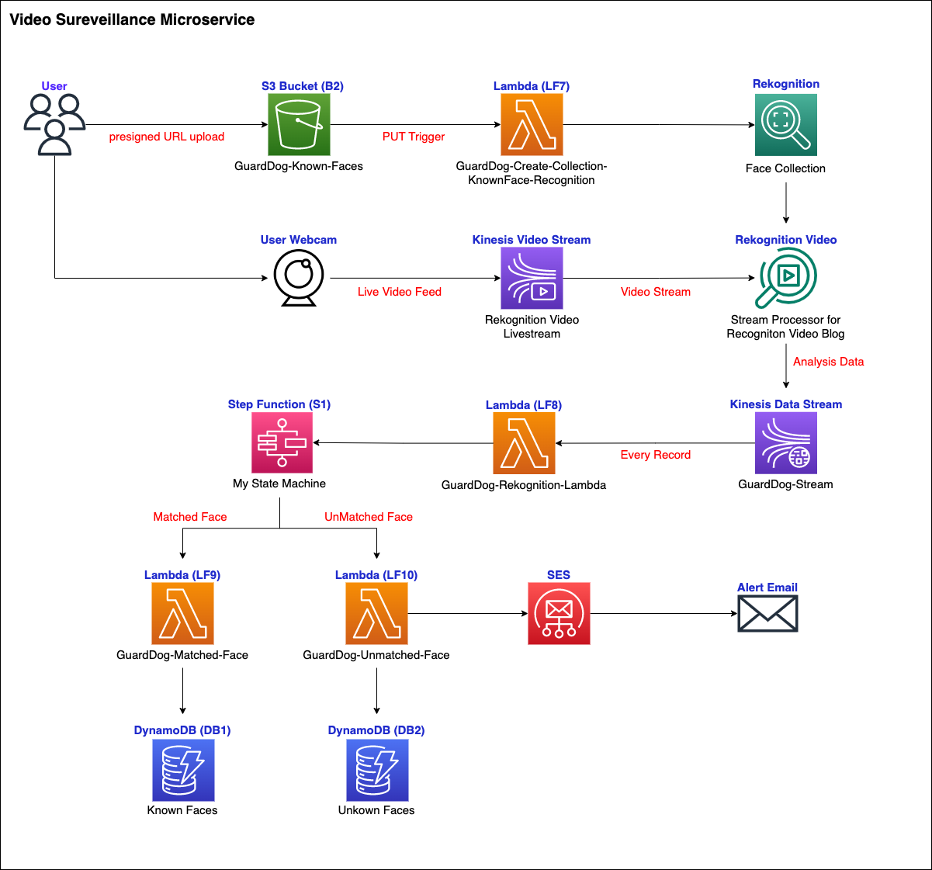
Architecture

Slide 6
fin.

